Slide 1
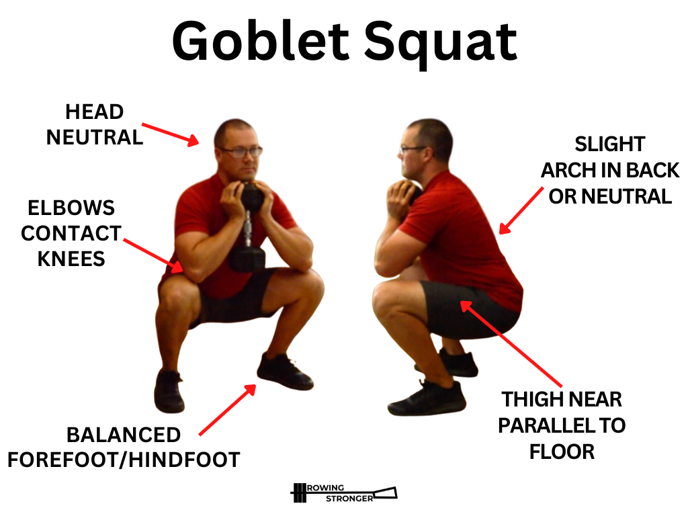
Question: Should we use Vector database for this (RAG) or use a structured database or hybrid?
Questions for Mentor. Date 3-May-2026
End to End Pipeline
Passed through Mediapipe to get x,y,z
Python Script to convert Mediapipe out to Biomechanics data
When User Uploads Video
Hosted in S3 Bucket
Save record : S3, processed Mediapipe, processed video analysis
LLM (Claude Sonnet 4.6) for Reasoning & Coaching
Gemini 3.1 Pro for video analysis (text output such as 10 reps, shoulder rounded)
Should we only pass biomechanics/ text into LLM or pass the video uploaded as well?
RAG/
Passed through Mediapipe to get x,y,z
Python Script to convert Mediapipe out to Biomechanics data (E.g Knee ANgle - 90%, Time taken to go down = 3 sec etc)
20-30 Squat Videos
Sam 3 model for video analysis (text output e.g 10 reps, shoulder rounded)
Save in a Vector Database/Regular DB
If just good tips are saved without reference image/video, can the LLM reason if that user’s video (knee angle etc) has good form?
10-20 Form Tutorial videos
Audio transcription to text (good form)
Some data are structured (e.g knee angle, some are unstructured e.g image, audio transcription) -- Do we need just vector DB or hybroed of vector + regular?
Images
Gemini Flash (form image & text)
User Data
Onboarding (e.g Past injury)
Weight input by user (for current video)
Past form analysis score, insights
Save in a structured DB
Notes:
LLM take the video and transcribe , and break it into specific data points → save in a relational database, or parent child retriever (video is the whole content, parts of it can be used for chunking..) JSON - exercise, no of reps (etc from mediapipe) → costs less for LLM to process, or written out paragraphs from m Hybrid retrieval → Qdrant (chunks → hybrid search on its own, sparse for exact match like “squat”, dont have to store it in vector DB)

